Slide 1
FYP Proposal Presentation
Wyman-1
Application for image recovery
LI Jia Xin 12382431
Jiao Guang Yi 12387856 Wang Jiawei 12395870
YANG Jia 12403074
2022/10/14

Slide 2
Table of the content
Cover Page
Table of Content
Part I. Introduction
A. Introduction
B. Project Aim
C. Project Objectives
D. Value Propositions
Part II. Background or Literature Review
A. Review of Existing or Related Solutions for the Problem
B. Highlight of the proposed solution
Part III. Preliminary Methodology
A. Overview
B. Requirements, Technical Gap
C. Architecture or High-Level System Design
References
Appendix I. Responsibilities

Slide 3
Part I. Introduction

Slide 4
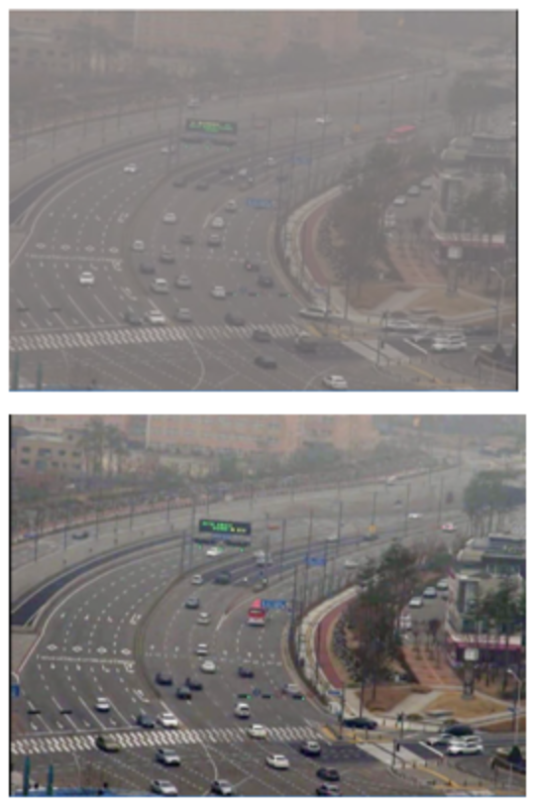
Introduction
Application for image processing
Main Functions:
Rainy picture restoration
Hazy picture restoration
Image denoising
Image compression
Current areas:
Sequential images like video
Single image
Methods:
Algorithms
AI

Slide 5
Project Aim
Reduces visual distortion caused by rainy and foggy days or dark environments.

Slide 6
Objectives
1. Learning: refer to the literature, learn and compare the advantages and disadvantages of each method
2. Collection: data collection of badly affected images and normal images
3 Algorithm: Analyze the data to identify and remove the bad factors in the picture
4 Modeling and training: design appropriate algorithms based on current technology to build models and train artificial intelligence
5 Testing and debugging: test and debug the implemented modules
6 Integration: Integrate the above modules into the prototype application
7. Evaluation: test and evaluate the prototype performance, and further improve the algorithm and prototype

Slide 7


Value Proposition
Obviously, the topic of our FYP has had already a bunch of solutions available now. Taking the project as an approach to studying, however, we are trying to rebuild a similar project by our own efforts and we could learn from the process of researching and implementation, which also benefits our future deeper study in AI and is a good content for CV

Slide 8
Part II. Literature review

Slide 9
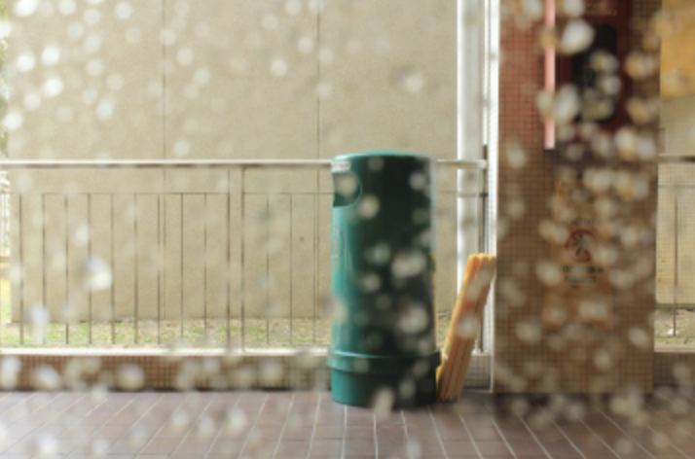
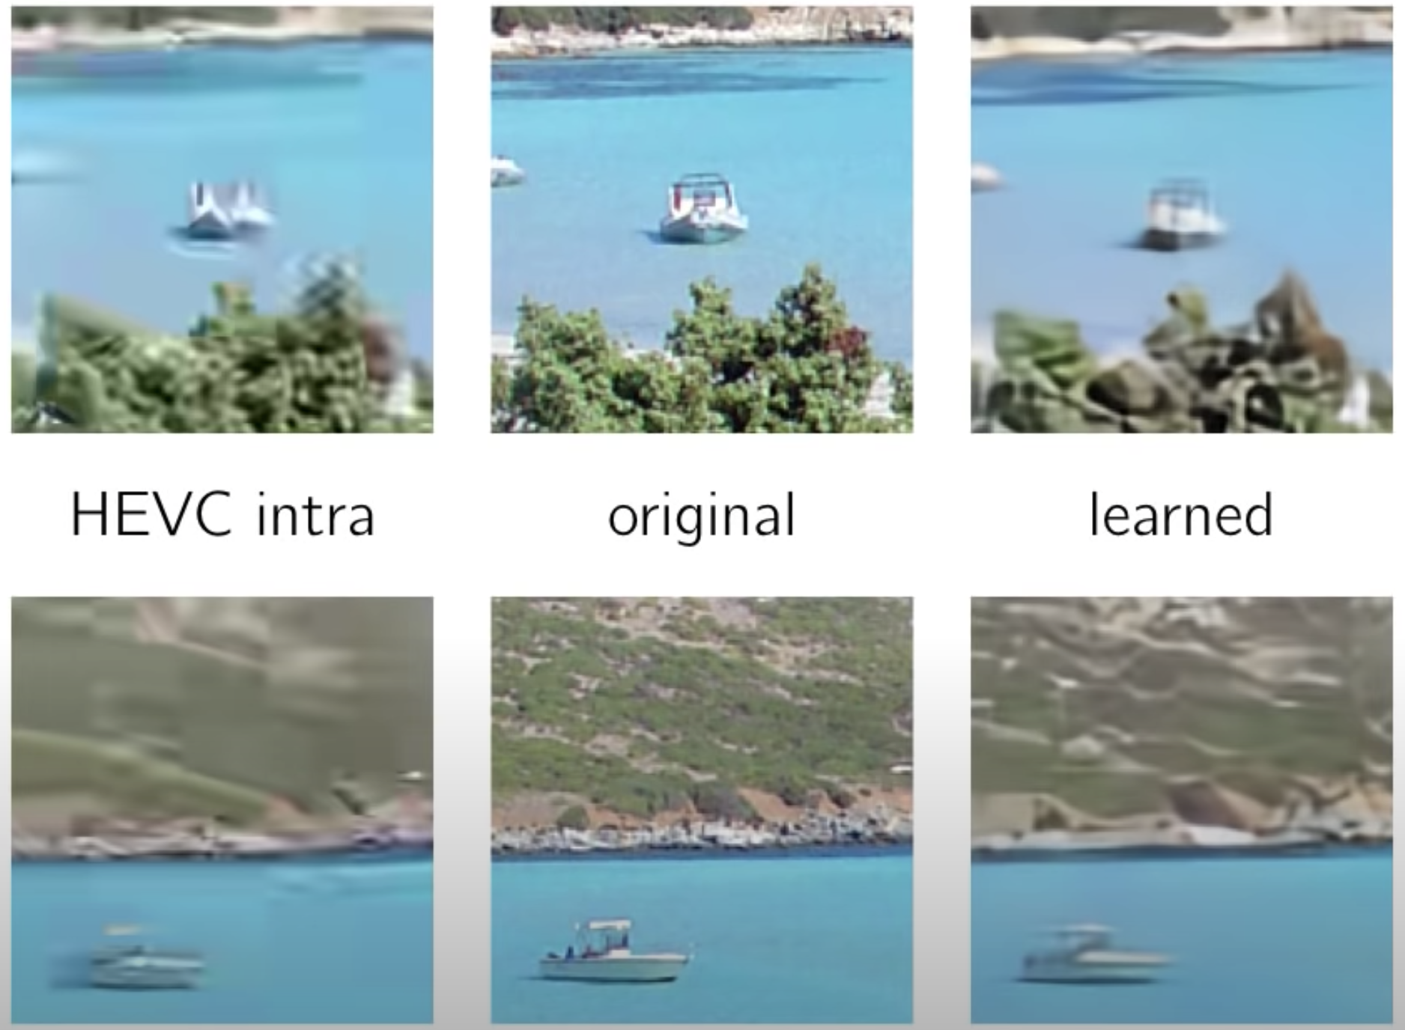
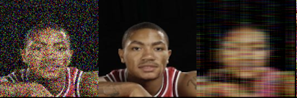
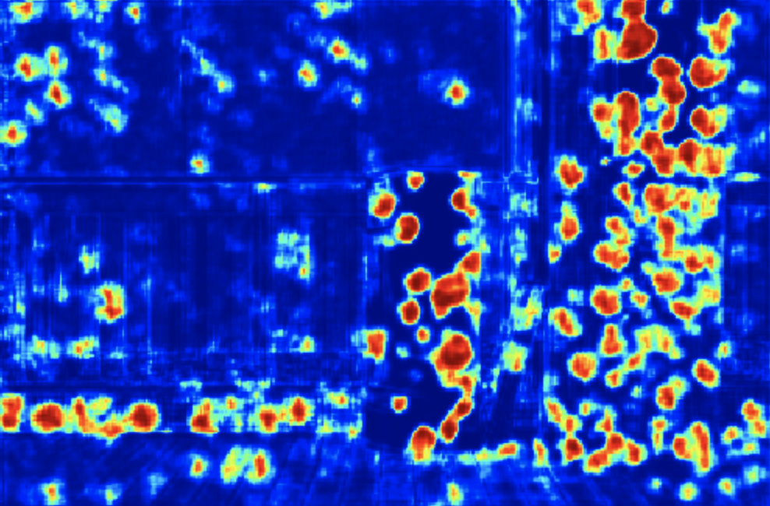
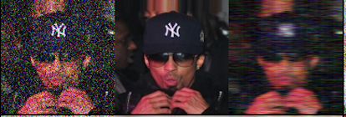
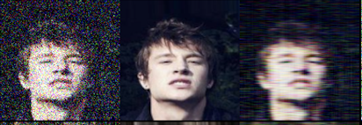
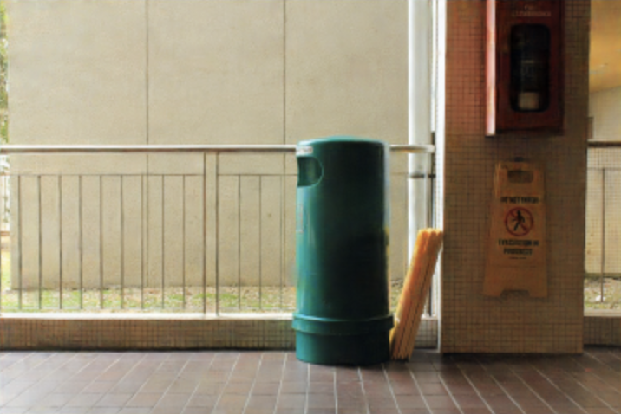
A quick introduction to our recent survey
Image Processing Application
noisy
original
denoising
ep1
ep10
ep20
Image Denoising
Image Compression
Raindrops Removal

Slide 10
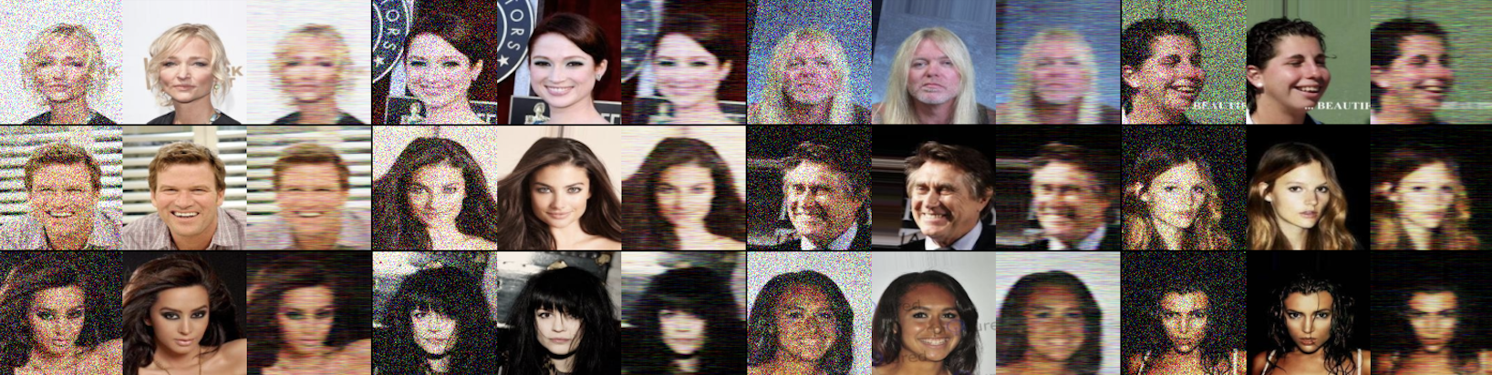

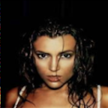


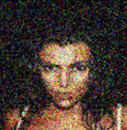
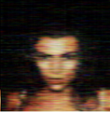
Image Processing Application (1)
Image Denoising
ep13 8,101/162,709
GAN-like autoencoder
+
this is correct
noise
original
input 1
try to match this
No matter how real it is,
fake data!
input
output
input 2
noisy
denoised
Generator
Discriminator
how good you are
Credit: CelebA training Dataset

Slide 11
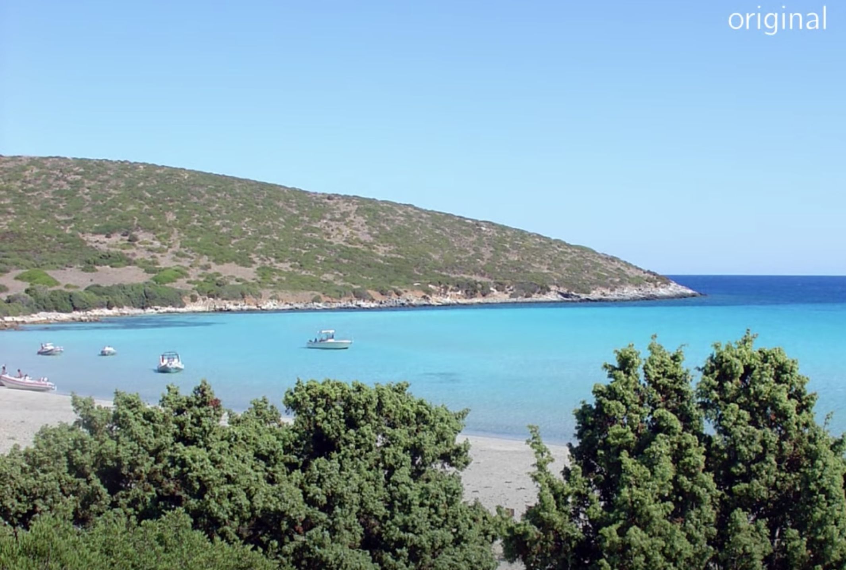
Image Processing Application (2)
Image Compression
Bitrate: 1.3 bit/pixel

Slide 12
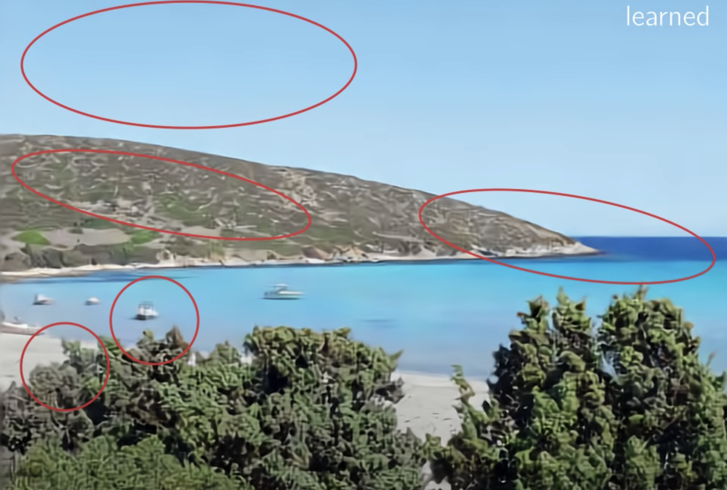
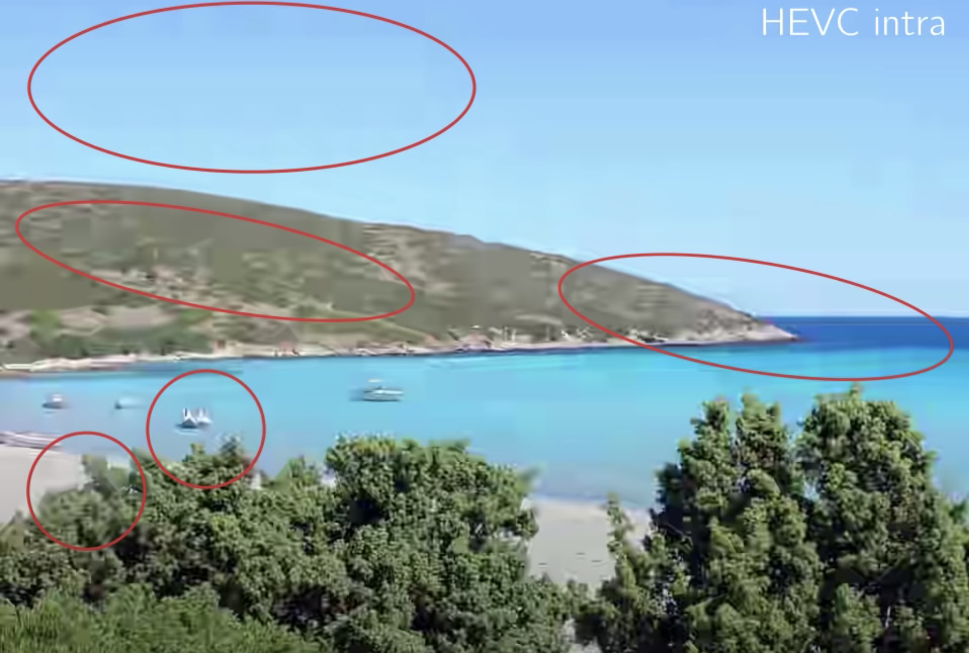
Traditional Image Compression Method:
Multi-step
(block partitioning: staircasing in the sky)
Linear Transform
(structural distortion: the boat)
Some frequency transform
(ringing at the corner)
Bitrate: 0.11 bit/pixel
Bitrate: 0.1 bit/pixel
Learned Image Compression Method:
End-to-End
(Better bit allocate: More natural))
Although we might lose some details
(Better visual impression)

Slide 13
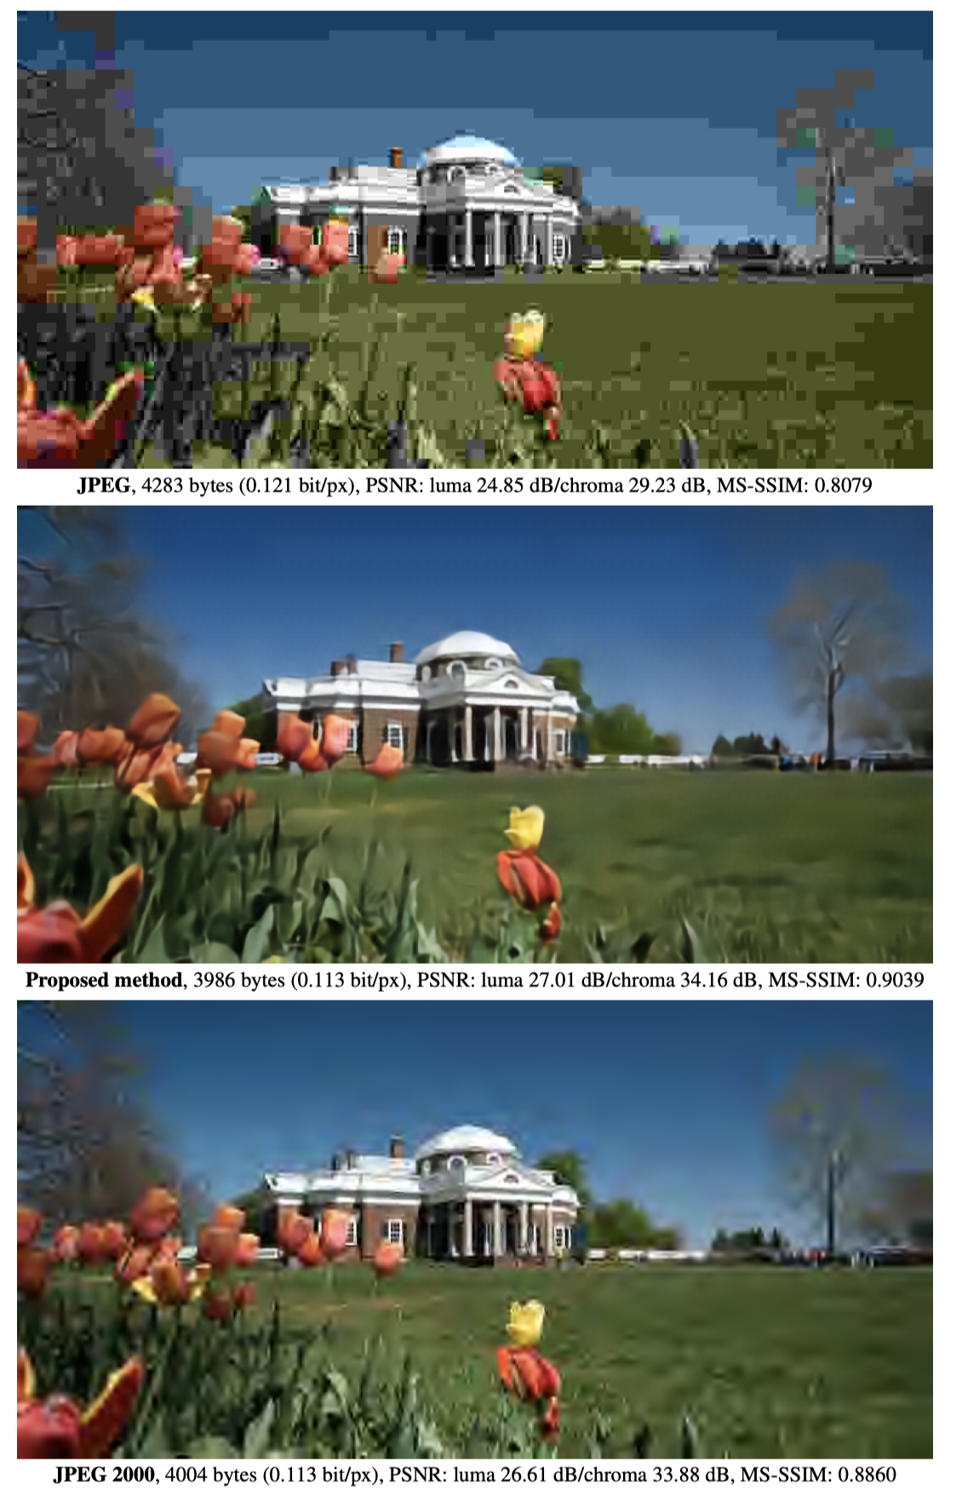
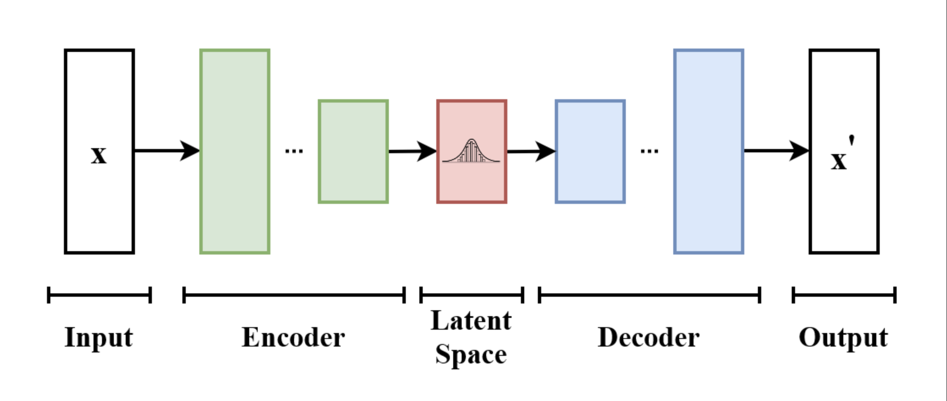
Variational Autoencoder
Don’t quite catch the idea, though now.
Credit: J Ballé et al. Paper 2017

Slide 14
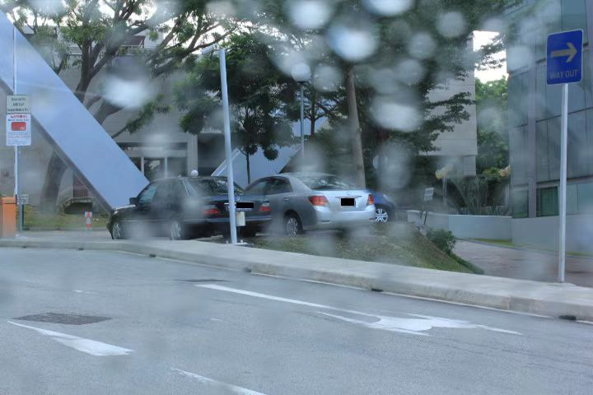

Slide 15
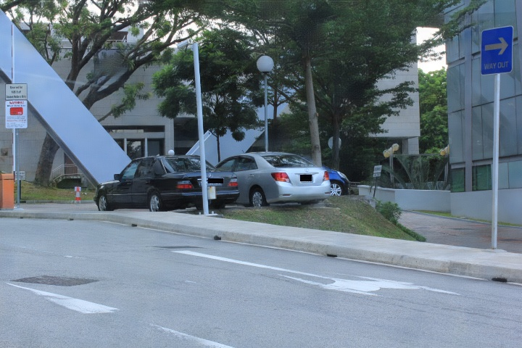
Solution 1

Slide 16
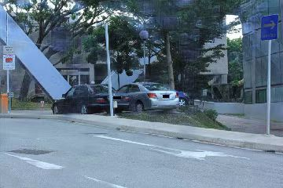
Solution 2 [2]

Slide 17
Solution 2

Slide 18
Conclusion
In solution 1[1], we take a picture from dataset to test, the result shows well.
However, if we take a random picture online which is a unfocused image, the result is not that good.
The solution 2[2] is based on solution 1 and makes adjustment to the neural network architecture. However, there are some extra fuzzy things compared to the result of solution 1.

Slide 19
Part III. Preliminary methodology

Slide 20
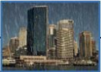
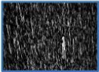
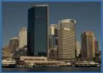
Overview:
Taking one of our tasks as example, we want to remove rain from a graph
We roughly consider the graph with rain(I) composed by the background graph(B) plus graph of rain(R). I = B + R.
So basically, the thing we are going to do is that we can input the graph into a CNN and study the feature of rain. Finally, we can get graph R, then B = I - R
+
Input(I)
Rain(R)
Background(B)
-
=
I
R
B(Our goal)
[1] Figure 3.1

Slide 21
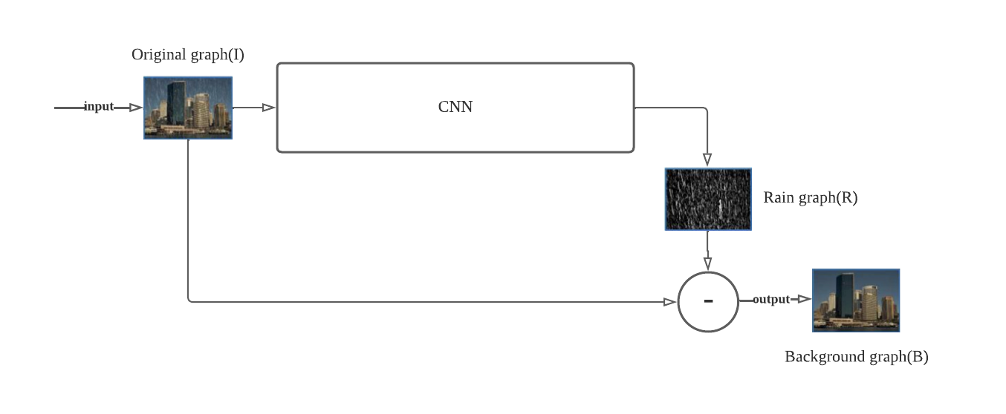
Architecture from high-level
Requirements:
CNN stands for convolutional neural network, which is used for getting rain features.
Minus mark stands for getting B by I minus R

Slide 22
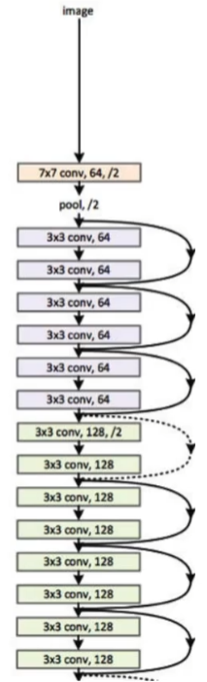
Example: a structure of CNN(ResNet)
[2] Figure 3.2

Slide 23

Technical gaps
Linux: some open source code can only run under Linux environment
PyTorch: An open source machine learning framework running on python
AI knowledges: needs time

Slide 24
Part IV. References and appendix

Slide 25
References
[1] rui1996, "github," 30 6 2018. [Online]. Available: https://github.com/rui1996/DeRaindrop.
[2] MaybeShewill-CV, “github,” 13 6 2022. [Online]. Available: https://github.com/MaybeShewill-CV/attentive-gan-derainnet.
[3] Findsth, “cnblogs,” 23 06 2018. [Online]. Available: https://www.cnblogs.com/zhang716921/p/9216042.html.
[4] Linus有点牛, “bilibili,” 6 6 2022. [Online]. Available: https://www.bilibili.com/video/BV1zF411V7xu?p=11.

Slide 26
Appendix I. Responsibilities
Dehaze: YANG Jia
Denoise: WANG Jia Wei
Derain:
Rain drop: JIAO Guang Yi
Rain streak: LI Jia Xin
Integration: to be determined
…

